Slide 1
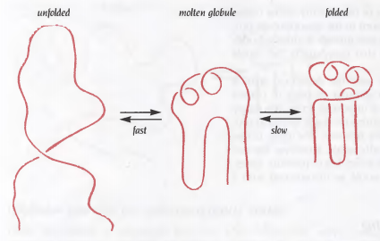
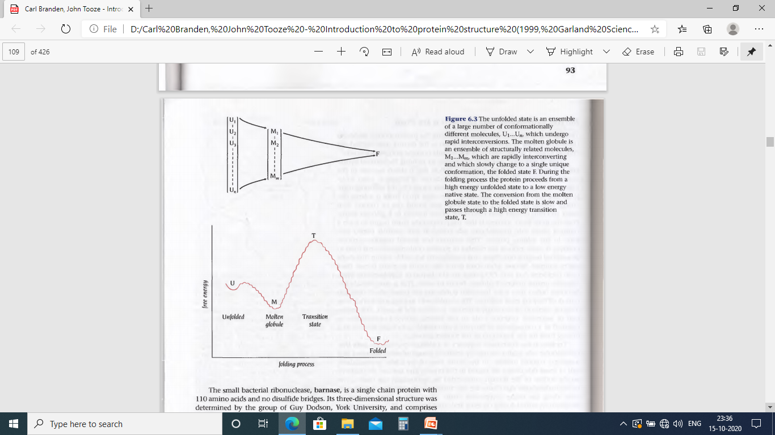
The first observable event in the folding pathway of proteins is a collapse of the flexible disordered unfolded polypeptide chain into partly organised globular structure, Molten Globule
Formation of molten globule is a fast event in the folding pathway, usually within the deadtime of experimental observation (few milliseconds)
The molten globule has most of the secondary structure of the native state and in some cases even native like positions of the α helices and β strands
It is less compact than the native structure and proper packing interactions in the interior of the protein have not been formed
The interior side chains may be mobile, more closely resembling a liquid than solid like interior of native state
Loops and other elements of surface structure remain largely unfolded, with different conformations. Thus molten globule is not single structural entity but as an ensemble of related structures that are rapidly interconverting
In the second step (~1 second) a single native structure is formed through the formation of native interactions including hydrophobic packing in the interior, fixation of surface loops

Slide 2
What is the Driving force for the collapse of randomly oriented unfolded polypeptide chain to molten globule ?
A little change in ∆G by forming H-bonds in α helices and β sheets
• as unfolded state has equally stable H-bonds with water
secondary structure formation can not be thermodynamic driving force for protein folding!
Large ∆G by bringing hydrophobic side chains out of contact with water to the interior
Likely scenario ⇒ The polypeptide chain begins to form a compact shape with the hydrophobic
side chains at least partially buried early in the folding process
Important consequences : • It vastly reduces the number of possible conformations that need to be
searched because only these that are sterically allowed can be sampled
• When some of the side chains are partially buried, –NH and –CO groups of
their backbone are also buried in hydrophobic environment and are unable
to form H-bonds with water
This is energetically unfavourable until they form H-bonds to each other
⇒ formation of α helices and β sheets
The formation of secondary structure (α helices and β sheets) early in folding process
can therefore be regarded as a consequence of burying hydrophobic side chains and
not as a driving force for the formation of molten globule

Slide 3
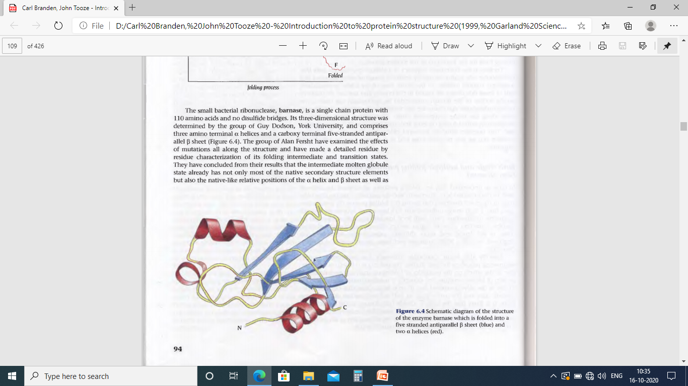
Folding: Protein molecule proceeds from high energy unfolded state to a low energy native state through metastable intermediate with local energy minima separated by unstable transition state of high energy
⇒ important to characterise these intermediate states
To investigate the folding pathway Alan Fersht developed an unique technique:
Effect on the energetics of folding upon single site mutation in protein of known structure
Example: Let, Ala to Gly mutation in the solvent exposed face of an α helix results in destabilisation of both intermediate and native states then α helix has already formed in the molten globule state. If the mutation destabilises the native state but not the intermediate state then α helix has not formed in the molten globule state.
The intermediate molten globule state has not only most of the native secondary structural elements but also the native like relative positions in the α helix and β sheet as well as the relative positions of the β strands within the β sheet
Barnase
Folding of Barnase proceeds through single major transition state and consequently through one major pathway

Slide 4
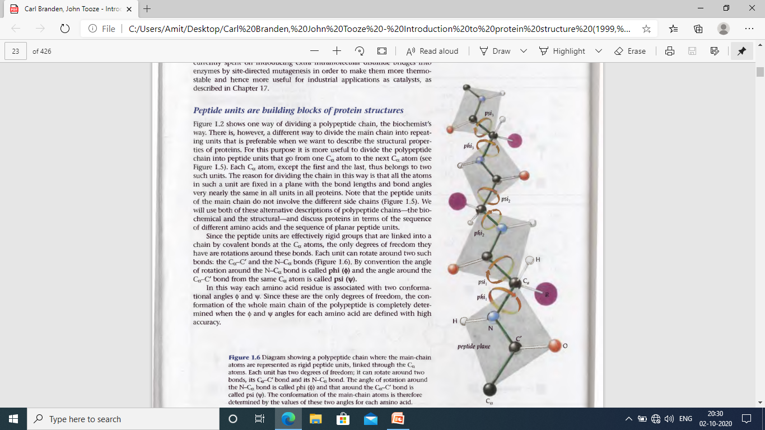
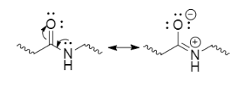
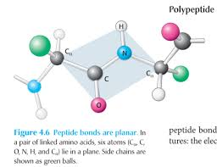
Different way to visualise the polypeptide chain:
Peptide units do not have the side chains
Peptide units are rigid
Each unit can rotate around C_{α} ̶ C’ and N ̶ C_{α} bond
Angle of rotation around N ̶ C_{α} : phi (φ)
Angle of rotation around C_{α} ̶ C’ : psi (ψ)
Each amino acid residue is associated with two conformational angle: φ and ψ
These are the only degrees of freedom that define the conformation of whole main chain

Slide 5
φ and ψ are examples of dihedral angles which are the angles between two intersecting planes

Slide 6

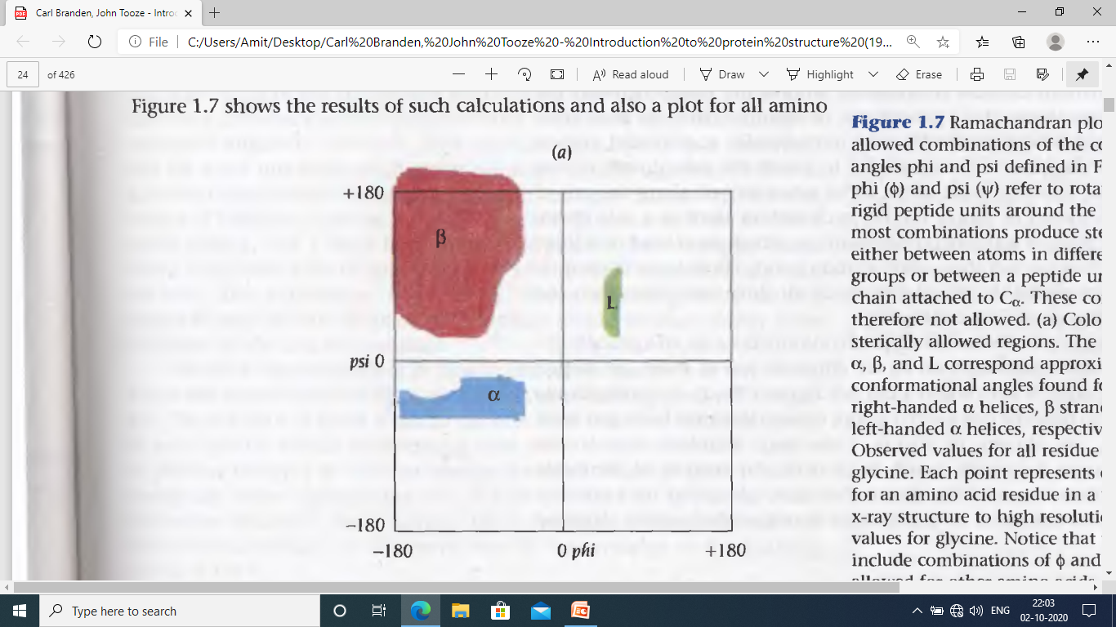
Most combinations of φ and ψ angles for an amino acid are not allowed due to steric collisions between side chains and main chain
D and L forms of an amino acid, which are mirror image of each other, have different allowed φ and ψ angles
HIV-1 protease – D-enzyme, made of D-amino acids, is exactly the mirror image of L-enzyme, made of L-amino acids
Observed φ and ψ angles for glycine
Observed φ and ψ angles for all amino
acid residues except glycine in a well defined X-ray structure
Ramachandran
plot=> calculations of sterically allowed regions
α: right handed
α helices
β: β strand
L: left handed
α helices

Slide 7
